Slide 1
Mobile Phone View System

Slide 2


Have you ever think of:
Which mobile phone should I buy?
I want to see the latest mobile phone product in the market

Slide 3
About us
IT company providing application development service.
Cooperate with the Digital Limited, which is a company selling mobile devices.

Slide 4
Objectives
Show all product list with specification and discounted price.
People want to find the latest product.
Show products with user selected Brand only.
People want to find products according to their priority on brand.
Provide suggestions to user according to their expectations.
People have difficulty in selection.
Out program gets their preference and lists suggested products

Slide 5
Project Planning

Slide 6
Project Team Organization
Member | Role
 | Programmer
 | Testing Engineer
 | Programmer
 | Project Manager
 | Programmer
 | Configuration Manager
 | Testing Engineer
Member | Email
 | nancychung03010301@gmail.com
 | waihingli3@gmail.com
 | be4562007@gmail.com
 | billyngbackup@gamil.com
 | pangpangpangckp@gmail.com
 | ottoy1117@gmail.com
 | yukkyip3@gmail.com

Slide 7
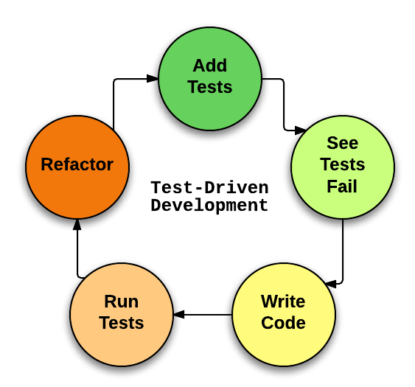
Software Development Methodology
We use the Test-driven approach.
Add Test case
See if test fails
Write code
Run Tests for the code
Refactoring the existing code
Then looping until the development end.

Slide 8
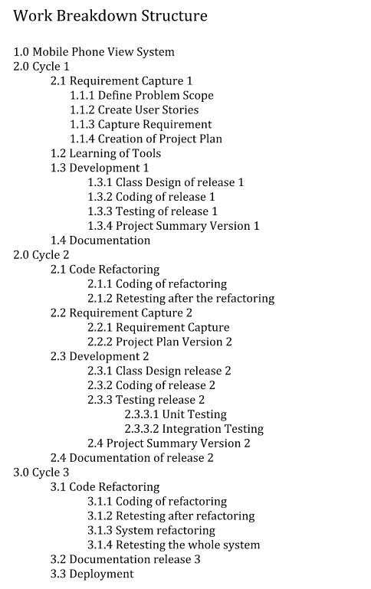
Work breakdown Structure
Total 3 Cycles
Each Cycle contains:
Requirement Capture
Coding
Testing
Refactoring

Slide 9
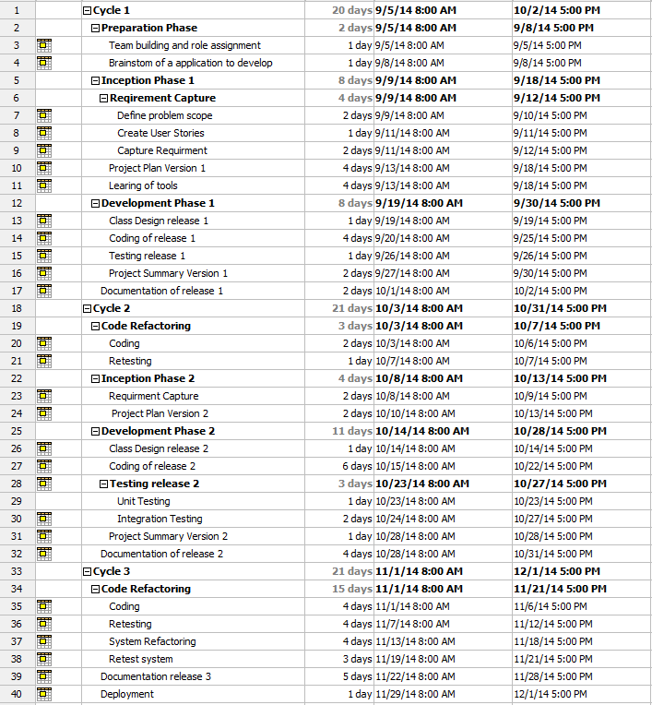
Project Schedule
80% of time:
Coding
Testing
Refactoring
20% of time:
Documentation
Planning
Learning of tools
For a Coding Task:
Assign a pair of programmer for a task
After that, assign pair of tester for testing.
Refactoring only when the fault is fixed.

Slide 10
Resource Assign
Resource is limited
Should be allocated well, otherwise we will waste resources.
For example, assign of task to the correct people.
To Solve this:
Task tracking list
Avoid someone is finished the task and wait for new task for a long time
Breakdown big task into small task, better utilization.
If the actual process is out of schedule
Schedule again immediately.
Actually we have out of schedule once and schedule again to make the project deliverable.
Also calculate the critical path to avoid the out of schedule

Slide 11
Requirement deliverable
Although adding many features is good
Time is limited.
Testing and documentation takes time. We cannot only focus on the features.
Result of cutting some features.
Example Feature when project brainstorming:
List All Product
List Selected Brand Product
Suggestion
Advertisement

Slide 12
The Software

Slide 13
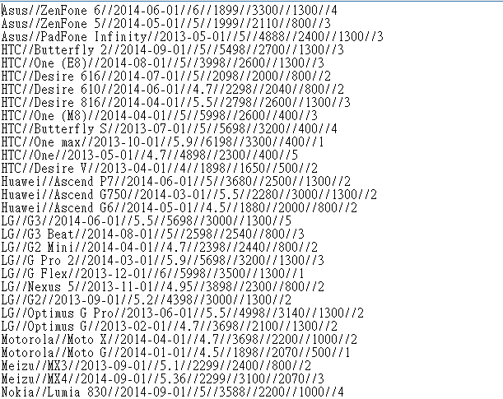
Before Program Start
Setting up the txt file inside src/file/
By Default, there is already 55 product
Treat as the Product data source
To add a product, just follow the format to add
No Modification of code is needed☺
Brand Name//Product Name//Release Date//Monitor Size//Price//camera pixel//battery size//available color

Slide 14
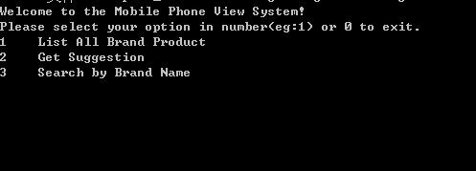
Program process
Function Name
User can input Corresponding function number

Slide 15
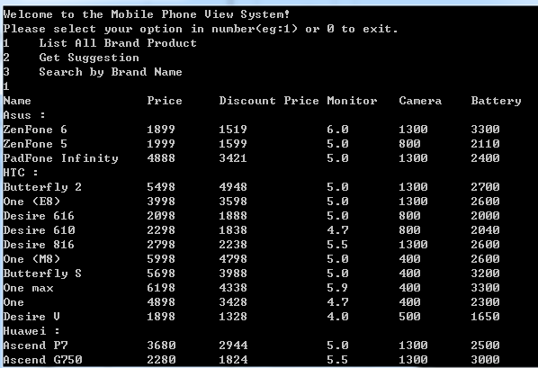
First Function: List All Brand Product
Important: The Discount Price doesn’t need to input by the Digital Limited, the system will calculate it base on the product release date to today’s date.
List All the Products Name, Price, Discounted Price, Monitor Size, Camera Pixel, Battery Size
After the function execution, the user can input any key to return to function menu

Slide 16

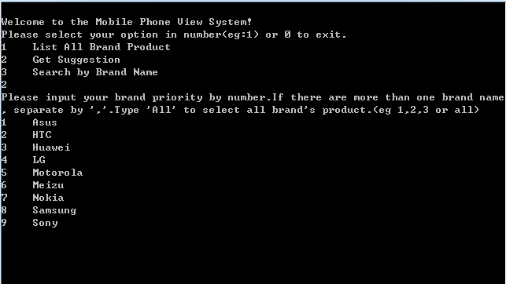
Second Function: Suggestion
First Part:
As user can have priority to specific Brand Product
Input: e.g.. 1,2,3
If user do not have a priority, just type “all”.
Exception handling: If user type invalid input, the program will notify you the invalid input and need to retype.

Slide 17
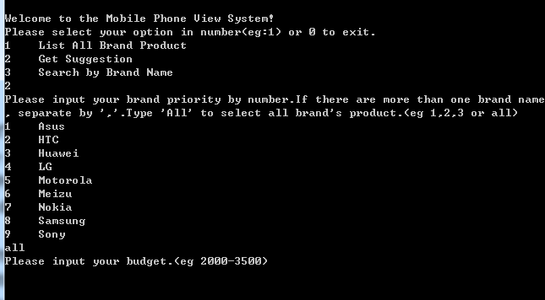
Second Function: Suggestion
Second Part:
User can input preferred budget.
Accept both range input and single input
Should >$200 and <$9000
Eg.2000-4000
Eg.5000<-Will treat as 0 to 5000
Exception handling: If user type invalid input, the program will notify you the invalid input and need to retype.

Slide 18
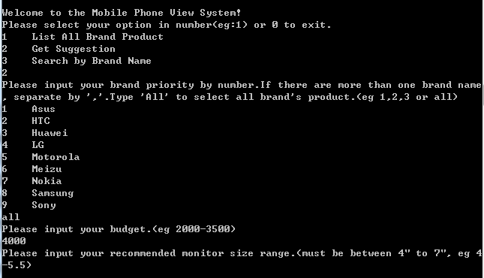
Second Function: Suggestion
Third Part:
User can have preferred Monitor size
Similar as Budget input, both range and single input.
Should >2” and <8”
Exception handling: If user type invalid input, the program will notify you the invalid input and need to retype.

Slide 19
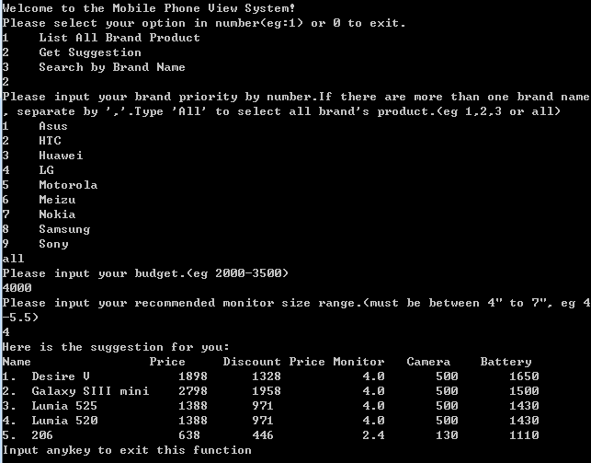
Second Function: Suggestion
Result:
A list of Product order by the product score
Product Score: Indicate the product fit with the user input.
High Score->More fit.
Besides:
The product score not only calculate by the user input
More internal Calculate
In Real Life, we will think of more battery size, higher camera pixel, etc.
So we include those to match real life cases☺

Slide 20
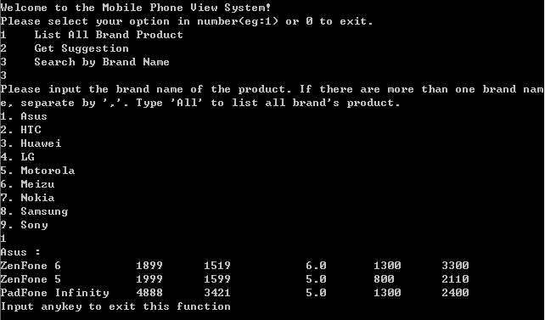
Third Function: List Selected Brand Product
Input the corresponding brand number
Product will be listed.

Slide 21
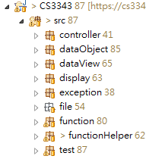
System Design
For IO class
For the data object storing, e.g.Product
For object that prevent raw data modify
For display class
Exception Handling
Product file
Function class
Helper for function for long computation
For test script

Slide 22
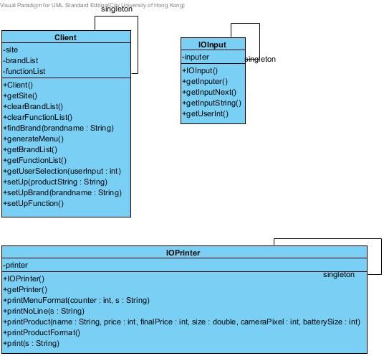
Design Pattern
Singleton:
Ensure there is only one client object
There is only one IO input for user.
There is only one IO output to user, which is the console.

Slide 23
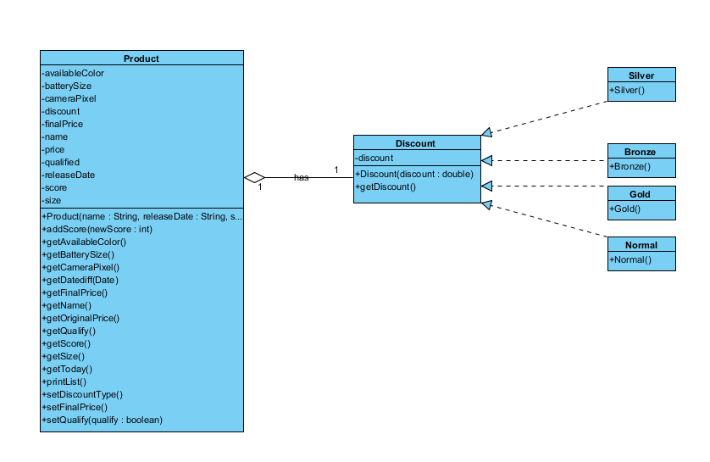
Design Pattern
State Pattern:
Product has a Discount object
There is many discount type, base on the today’s date compare to the release date.

Slide 24
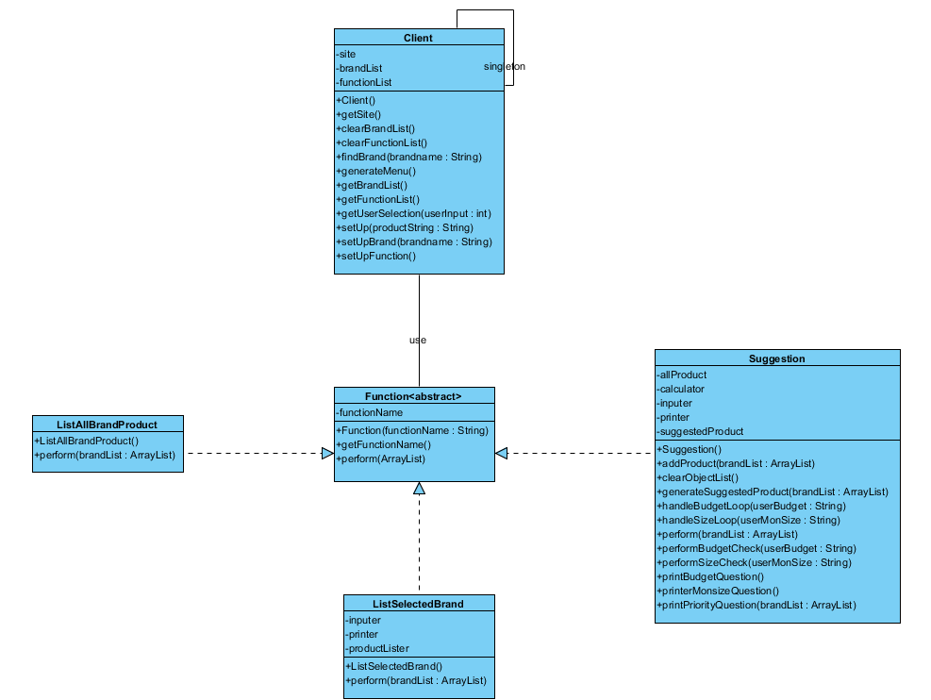
Design Principle
Dependency inversion principle:
Since higher module Client should not depends on Function, which is lower module
So abstract test is created to make higher module independent of the low-level module implementation details

Slide 25
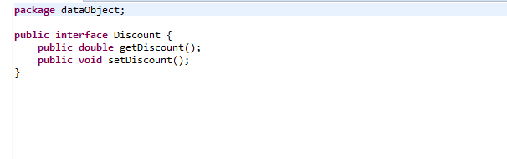
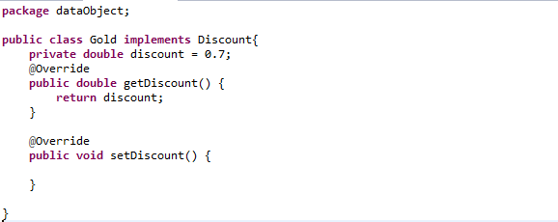
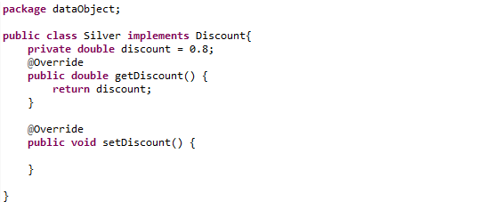
Code Refactoring
Problem 1:
Attribute discount repeated in each sub class
The content in the getDiscount() repeated

Slide 26
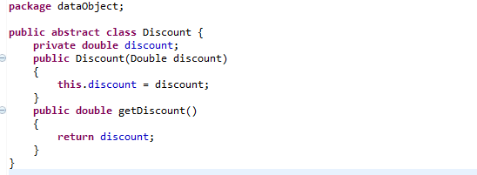
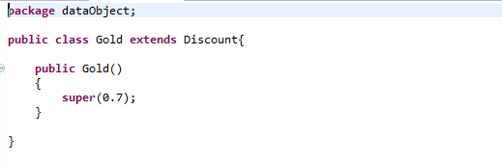
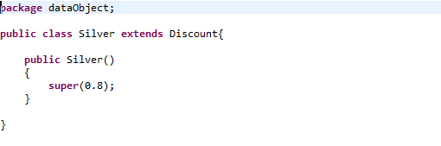
Code Refactoring
Solution:
Extract Method and Pull Up Method
No repeated now☺

Slide 27
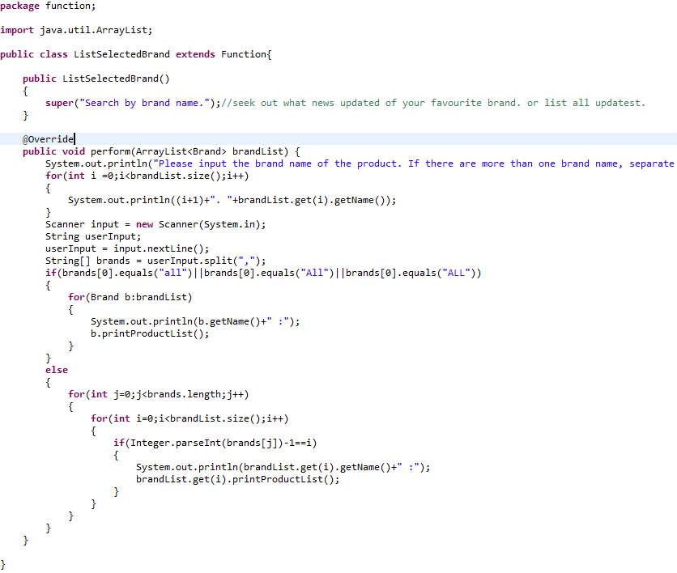
Code Refactoring
Problem 2:
Very long computation in the same method
Two responsibility in the method

Slide 28
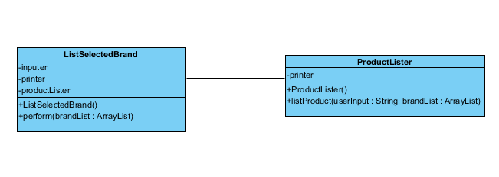
Code Refactoring
Solution:
Extract Method to Method Object
Separated two responsibility☺

Slide 29
Testing

Slide 30
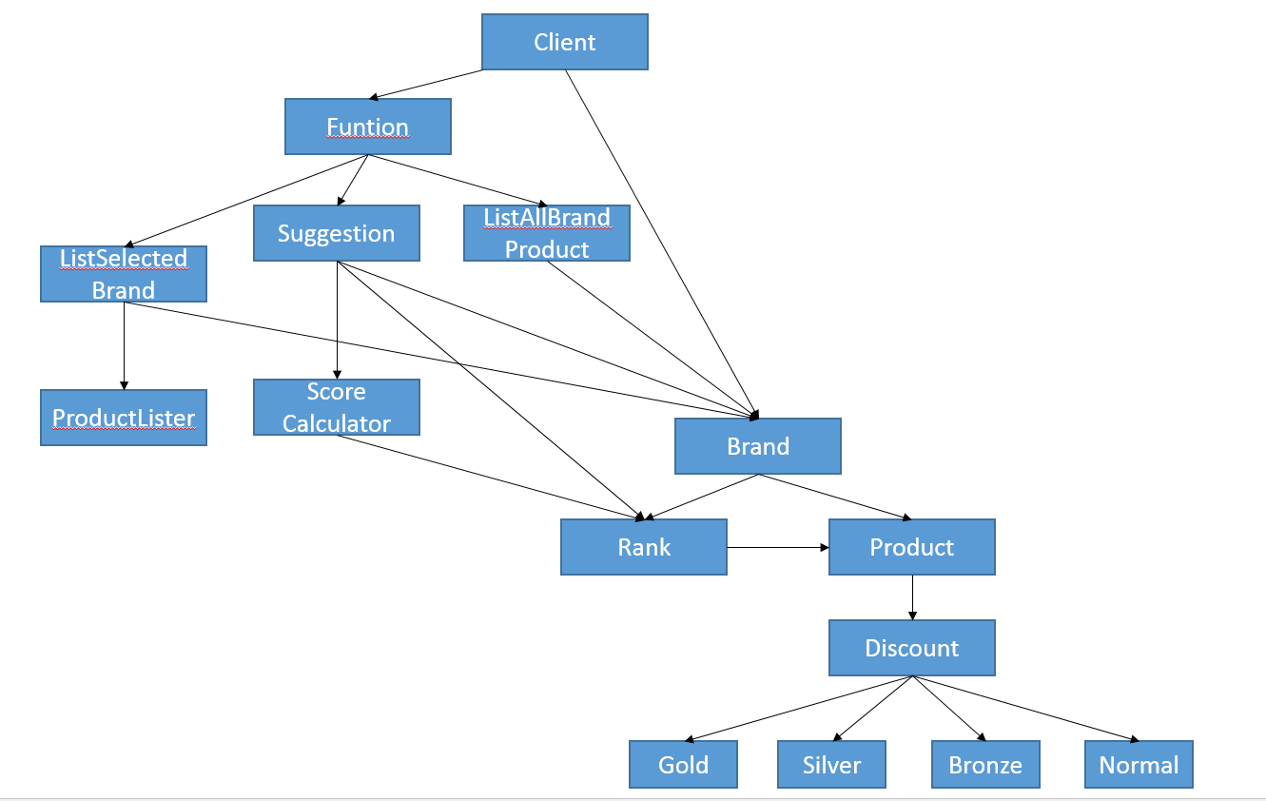
Hierarchy of Program Modules

Slide 31
Bottom-Up Approach
Unit Testing: Discount, ProductLister
integration Testing: Product, Rank, Brand, ListAllBrandProduct, Suggestion, Client

Slide 32
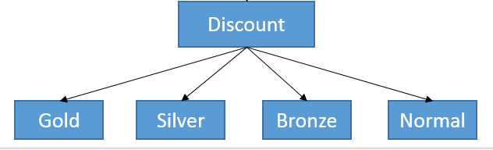

Discount:
ProductLister:

Slide 33
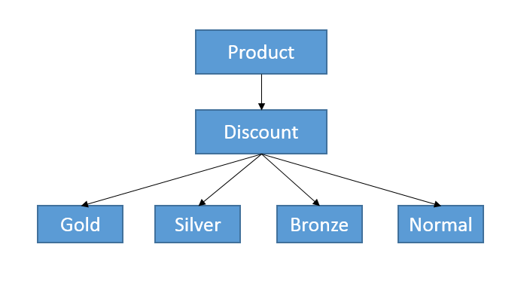
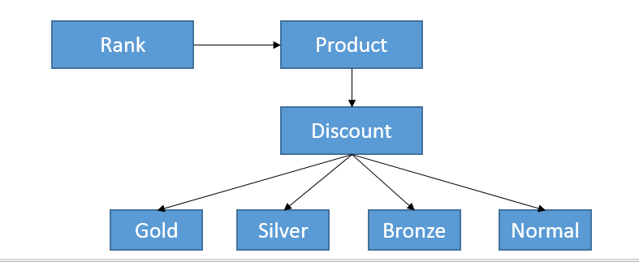
Product:
Rank:

Slide 34
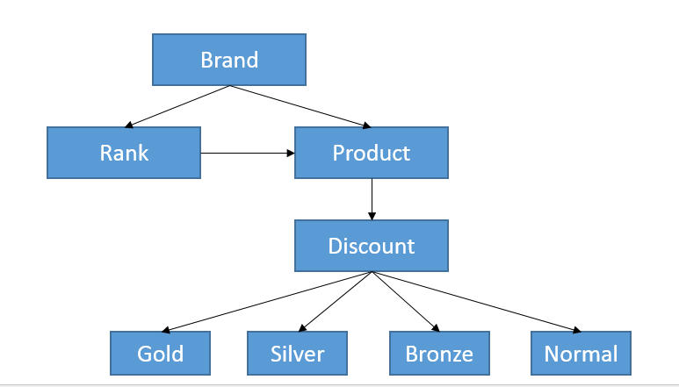
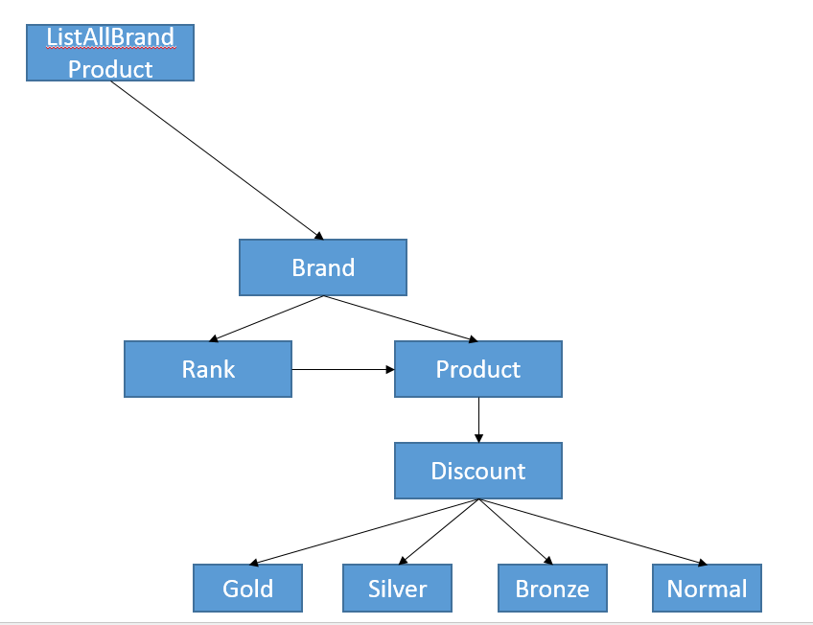
Brand:
ListAllBrandProduct:

Slide 35
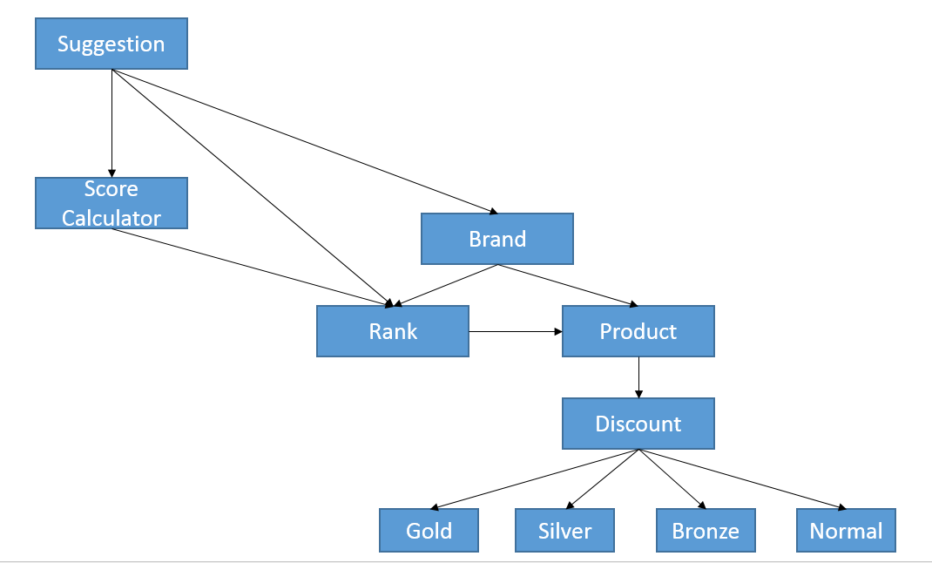
Suggestion:

Slide 36
Client:

Slide 37
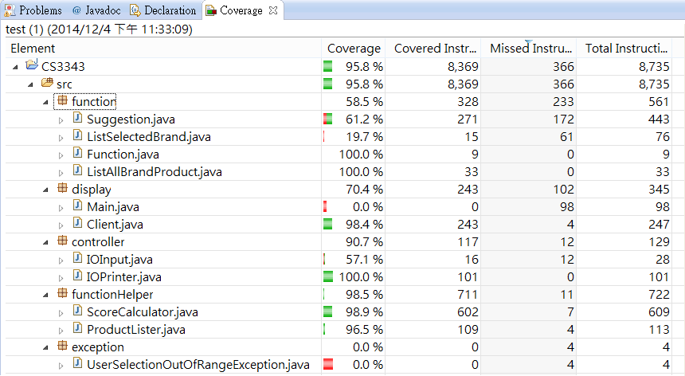
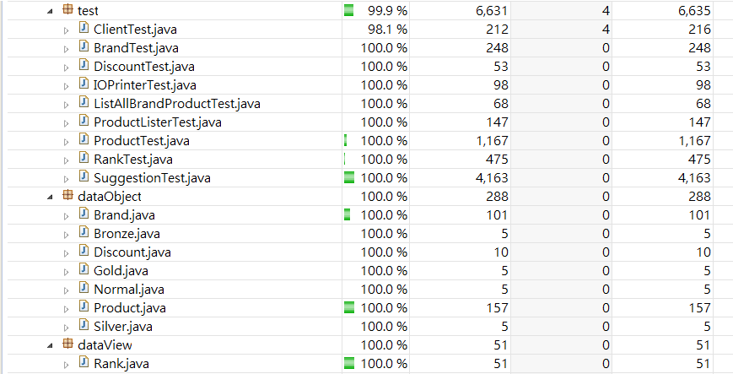
Test Coverage

Slide 38
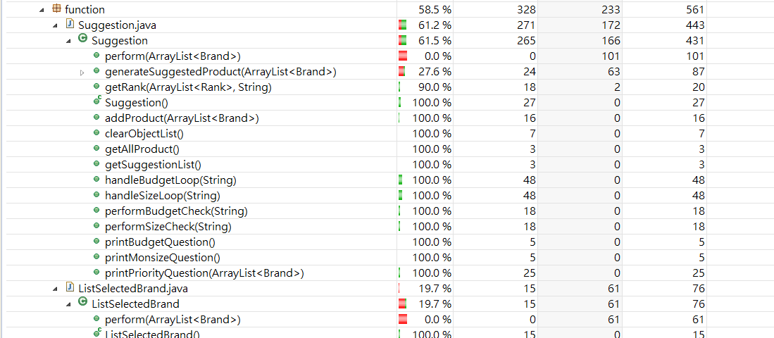
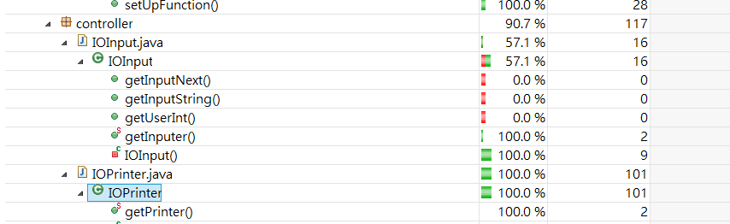
Test Coverage

Slide 39
Configuration

Slide 40

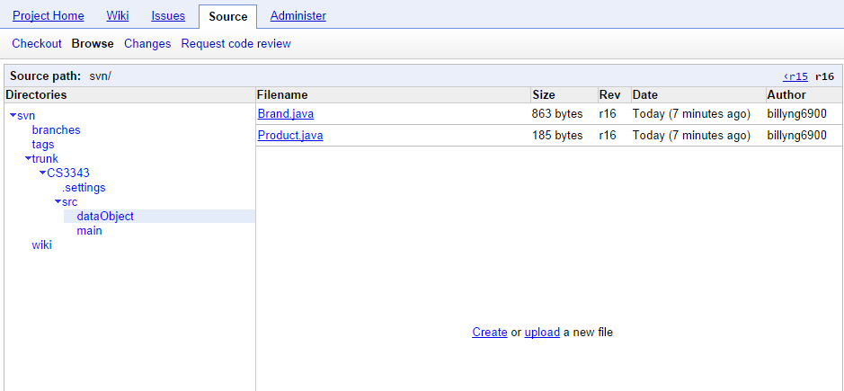
Configuration
It is a big problem to maintain the consistency of the code, document.
Version control tools:
Subversive
Which is a free java extension.
Server for version control:
Google code
Free space for code storage

Slide 41
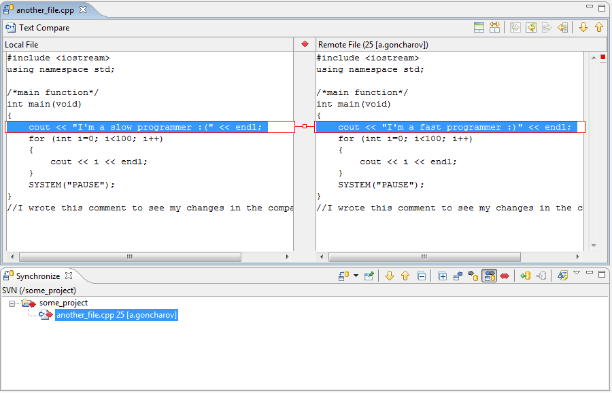
Configuration
Keep tracking on the check-in check-out issue
Only check-out the files that in-charged.
Check-in the files when all the error is fixed.
Subversive
Can View the check-in history
Auto-notify on the conflict issue
Which is cause by two programmer update the same file.

Slide 42
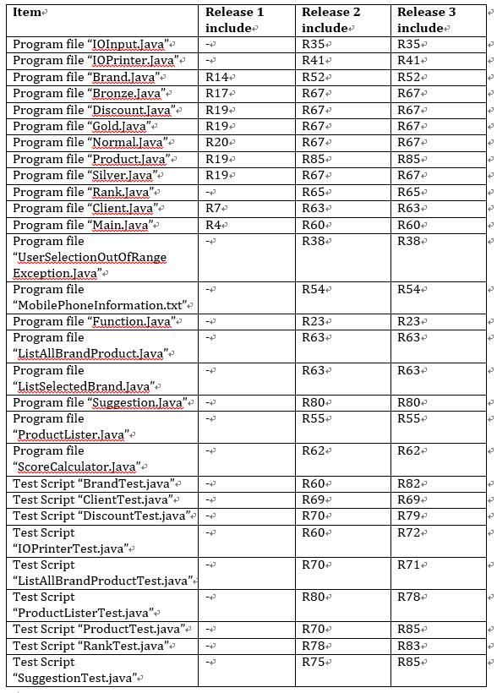
Configuration
Make a list of Configuration
Keep tracking of the Version control
Tracking of the version in different release.
To increase consistency.

Slide 43
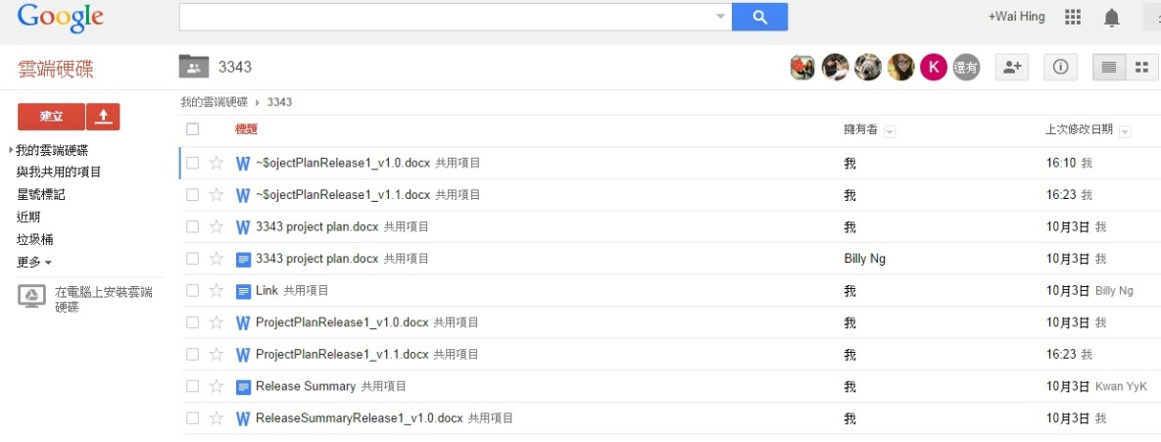
Configuration
For the version control of documentation
Document Version control tools:
Google drive
Share folders for exchange of document.
Keep tracking on the version control.
Indicated with v1.0,v1.1…….

Slide 44

Configuration
Development tools and testing tools:
Eclipse Kepler (4.3.2)
JUnit 4
EclEmma 2.3.2

Slide 45
FAQ

